Slide 1
TOPIC: iot based Replenishing of hospital supplies
-By Abhishek gupta

Slide 2
PROBLEM STATEMENT
It becomes difficult for hospital staff to manage the machines needed in the different operations that take place in a hospital and thus critical operation components can get depleted, resulting in a total machine shutdown thus making that particular device unusable. Also, It becomes difficult for hospital staff to manage the machine if the machine's condition is critical or it stops working, thus resulting in machine shutdown and making it unusable. Inability to do so will lead to them being rendered unproductive till these machines are not restored back to a fully functional state.

Slide 3
PROPOSED SOLUTION
An IoT-connected medical device can report back to the main system when the status of device or machine gets changed. And if the status changes, the department can raise a request for the device or an automatic request can be generated for the device to be repaired by the technician. Based on that request, the other hospital team will respond and update the request.
Also, connecting smart IoT enabled devices to lab devices can enable real-time monitoring, tracking, and response. The machine information can trigger alerts and automatic generation of request for servicing staff for servicing of the machine, thus limits the downtime and improves patient and care give satisfaction.

Slide 4
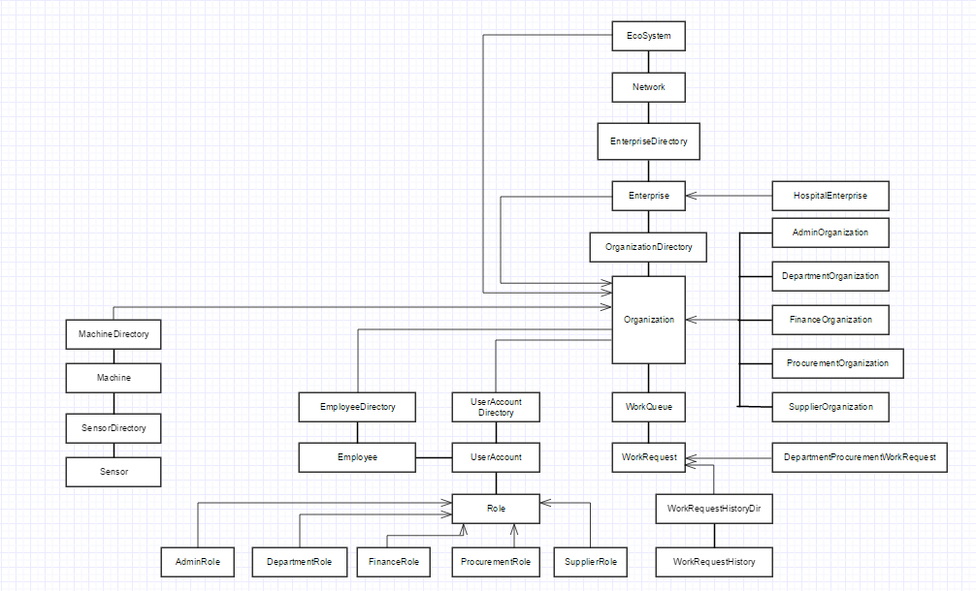
Object model

Slide 5
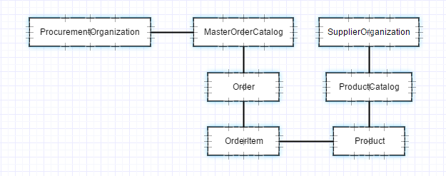

Slide 6
Key roles and responsibilities
DEPARTMENT STAFF:
Add Machines, Add Sensors, Raise request for Procurement organization if the machine is critical
PROCUREMENT STAFF:
Updates the request sent by department staff and processes the request further to finance and servicing organizations
SERVICING STAFF:
Repairs the machines and completes the request raised by the department staff
FINANCE STAFF:
Generates BI reports based on finance history
ENTERPRISE ADMIN:
Keeps record of work request history, generates excel files for record keeping

Slide 7
Key features
Graph generating the total time taken for a request, helping the organization improve its performance
Auto generated emails for notifying the user on account creation
Sound alarms to notify the staff when they have pending requests
BI reports to enhance organization performance
Exporting the entire request history across the organization to excel spreadsheets for storage and tracking purposes

Slide 8
THANK YOU

